Slide 1

Green University of Bangladesh
Department of Computer Science and Engineering (CSE)
Faculty of Sciences and Engineering
Semester: Spring, Year: 2022, B.Sc. in CSE (DAY)
LAB REPORT NO # 01
Course Title: Basic Structure and Syntax of C Programming Language
Course Code: CSE 104 Section: CSE 213 - DB (PC)
Lab Experiment Name(s):
Lab Report for Performing Basic Arithmetic Operations (addition, multiplication) Using C.
Student Details
Name | ID
Md. Shahidul Islam Prodhan | 213902017
Lab Date: 05 February 2022
Submission Date: 11 February 2022
Course Teacher’s Name: Md. Solaiman Mia, Assistant Professor.
[For Teacher’s use only: Don’t write anything inside this box]
Lab Report Status
Marks: | Signature:
Comments: | Date:

Slide 2
1. TITLE OF THE LAB EXPERIMENT
Lab Report for Performing Basic Arithmetic Operations Using C.
2. OBJECTIVES
In first problem two integer numbers are defined, we just find the sum of those number. And In second problem we will take two floating point number from user and multiply them.
3. PROCEDURE
Problem 1: Add two numbers (5 and 8) and display it’s sum like (5+8 = 13).
At first write the basic structure of C program. Then inside main function store integer value in variable a and b. And after that show the sum of those number using “printf” function.
Problem 2: User Input two numbers and display those numbers
Here, we will take two numbers from the user and store them in variable a and b. Then we scan those numbers using “scanf” function and finally print the product of those numbers using “printf” function.
Problem 3: User Input two numbers as input and display its sum.
First, we will take two numbers from the user and store them in variable a and b. Then we scan those numbers individually using “scanf” function. Then we sum those two variables and finally print the summation of those two numbers using “printf” function.
Problem 4: User Input two numbers as input and display its product.
First, we will take two numbers from the user and store them in variable a and b. Then we scan those numbers individually using “scanf” function. Then we multiply those two variables and finally print the product of those two numbers using “printf” function.
Problem 5: User Input two float numbers as input and display its sum [Follow the printing style of problem 5].
At first, we will take two floating numbers from the user and store them in variable a and b. Then we scan those floating numbers individually using “scanf” function. Then we sum those two variables which contains floating numbers and finally print the summation of those two numbers using “printf” function.

Slide 3
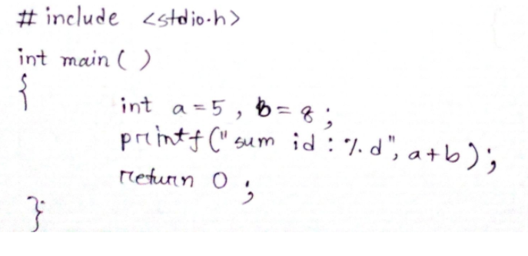
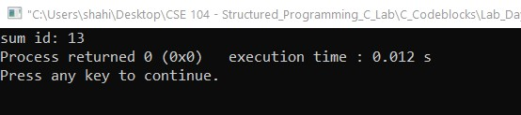
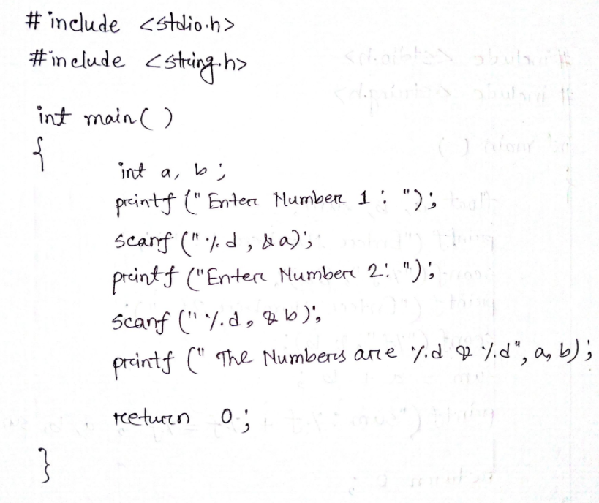
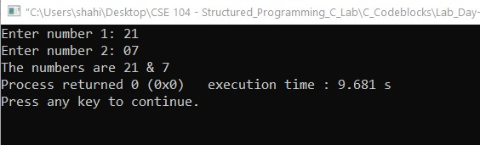
4. IMPLEMENTATION & TEST RESULTS
Problem 1: Add two numbers (5 and 8) and display it’s sum like (5+8 = 13).
Problem 2: User Input two numbers and display those numbers

Slide 4
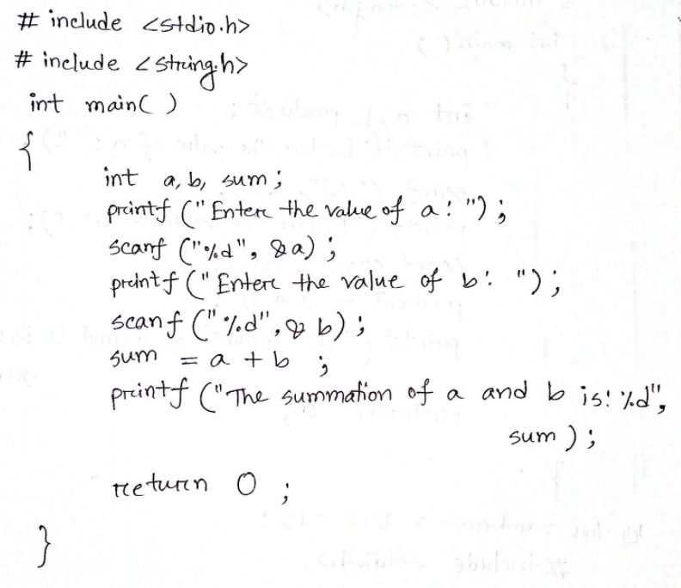
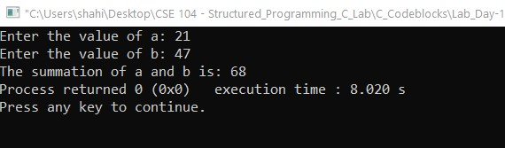
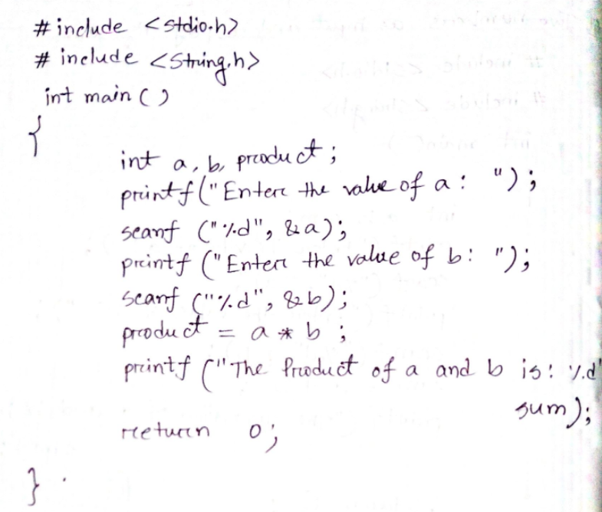
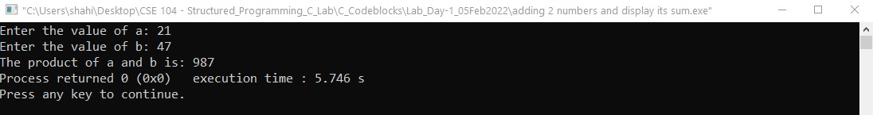
Problem 3: User Input two numbers and display its sum.
Problem 4: User Input two numbers and display its product.

Slide 5
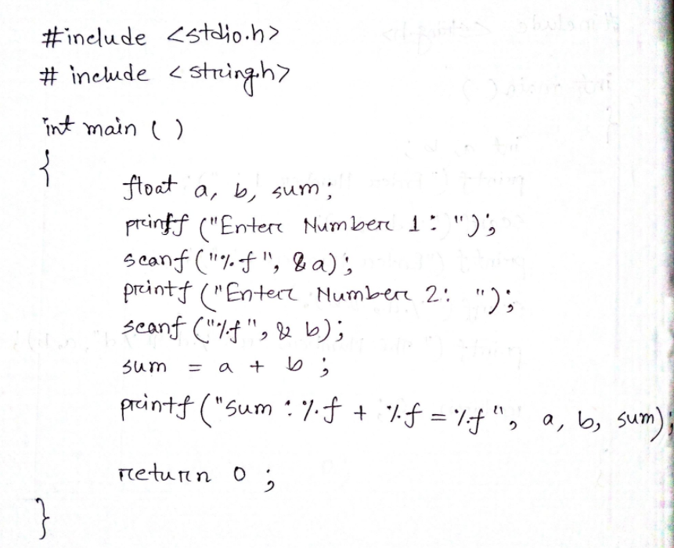
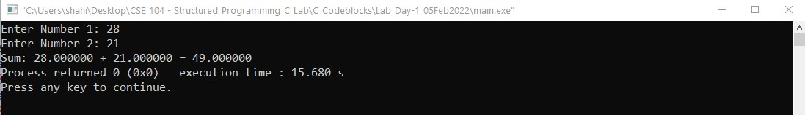
Problem 5: User Input two float numbers as input and display its sum [Follow the printing style of problem 5].

Slide 6
6. ANALYSIS AND DISCUSSION
In first problem of summating (5+8) we get the proper summation of two numbers which is 8. And similarly, in third problem which ask from user to input two numbers and show their sum, thus, we have achieved our expected result.
We solve those problems using CodeBlocks IDE and there were no errors occurred. And we can successfully print the output of those problems.
We have faced little bit difficulties while taking input from user and in summation of floating numbers.
We have not used any extra variable to store results. We have directly performed addition and multiplication operation inside “printf” function.
Solving these 5 problems, we have learned how to add/multiply both any integer and floating number using C. And now we can make a very basic calculator which can perform basic arithmetic problems of addition and multiplication.
7. SUMMARY
From the given experiments, we have learned the very basic implementation of C language in order to do some basic arithmetic expressions (i.e. 5, 5.0000) and perform some basic arithmetic calculation such as addition, multiplication (i.e. 21+7=28, 5*8=40). It introduces to using “printf” function and “scanf” functions in C.

